Slide 1
COMP 3500 Introduction to Operating Systems Synchronization: Part 1
Dr. Xiao Qin
Auburn University http://www.eng.auburn.edu/~xqin
xqin@auburn.edu
Notes:
50 Minutes Slides
To present the concept of process synchronization.
To introduce the critical-section problem, whose solutions can be used to ensure the consistency of shared data
To present both software and hardware solutions of the critical-section problem
To examine several classical process-synchronization problems
To explore several tools that are used to solve process synchronization problems

Slide 2
Recap
Process control
Process control block
Context switch
Process states
Two-state process model
Five-state model
Notes:
Chapter 3 Summary

Slide 3
Concurrency
Multiple Applications
invented to allow processing time to be shared among active applications
Structured Applications
extension of modular design and structured programming
Operating System Structure
OS themselves implemented as a set of processes or threads
Notes:
Multiple Processes
The central themes of operating system design are all concerned with the management of processes and threads:
• Multiprogramming: The management of multiple processes within a uniprocessor system
• Multiprocessing : The management of multiple processes within a multiprocessor
• Distributed processing: The management of multiple processes executing on multiple, distributed computer systems. The recent proliferation of clusters is a prime example of this type of system.
Fundamental to all of these areas, and fundamental to OS design, is concurrency. Concurrency encompasses a host of design issues, including communication among processes, sharing of and competing for resources (such as memory, files, and I/O access), synchronization of the activities of multiple processes, and allocation of processor time to processes. We shall see that these issues arise not just in multiprocessing and distributed processing environments but even in single-processor multiprogramming systems.
Concurrency arises in three different contexts:
• Multiple applications: Multiprogramming was invented to allow processing time to be dynamically shared among a number of active applications.
• Structured applications: As an extension of the principles of modular design and structured programming, some applications can be effectively programmed as a set of concurrent processes.
Operating system structure: The same structuring advantages apply to systems programs, and we have seen that operating systems are themselves often implemented as a set of processes or threads.

Slide 4
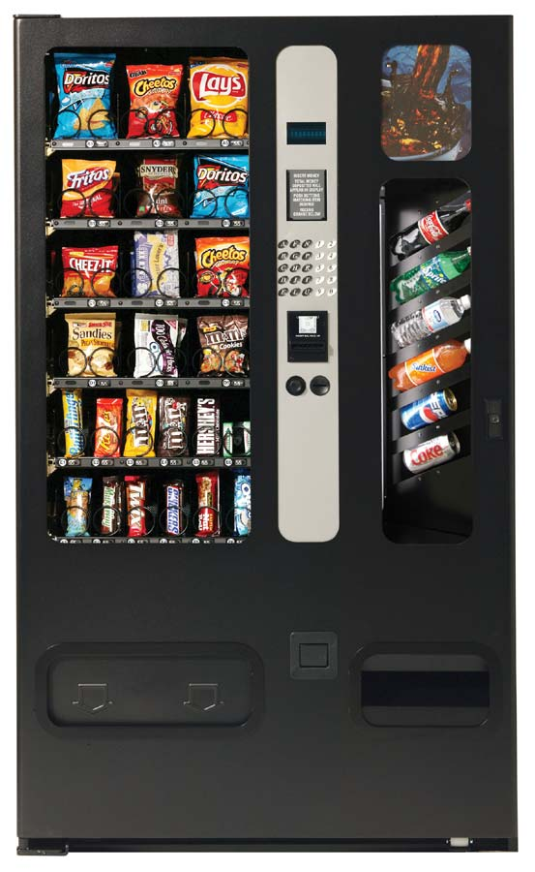



Example: the soda/HFCS machine
Soda drinker
(consumer)
Delivery person
(producer)
Vending machine
(buffer)
Slide courtesy: Dr. Jeff Chase, Duke University
Notes:
Principles of Concurrency
Interleaving and overlapping
can be viewed as examples of concurrent processing
both present the same problems
Uniprocessor – the relative speed of execution of processes cannot be predicted
depends on activities of other processes
the way the OS handles interrupts
scheduling policies of the OS
At first glance, it may seem that interleaving and overlapping represent fundamentally different modes of execution and present different problems. In fact, both techniques can be viewed as examples of concurrent processing, and both present the same problems. In the case of a uniprocessor, the problems stem from a basic characteristic of multiprogramming systems: The relative speed of execution of processes cannot be predicted. It depends on the activities of other processes, the way in which the OS handles interrupts, and the scheduling policies of the OS.
The following difficulties arise:
1. The sharing of global resources is fraught with peril. For example, if two processes both make use of the same global variable and both perform reads and writes on that variable, then the order in which the various reads and writes are executed is critical. An example of this problem is shown in the following subsection.
2. It is difficult for the OS to manage the allocation of resources optimally. For example, process A may request use of, and be granted control of, a particular I/O channel and then be suspended before using that channel. It may be undesirable for the OS simply to lock the channel and prevent its use by other processes; indeed this may lead to a deadlock condition, as described in Chapter 6 .
3. It becomes very difficult to locate a programming error because results are typically not deterministic and reproducible (e.g., see [LEBL87, CARR89, SHEN02] for a discussion of this point).
All of the foregoing difficulties present themselves in a multiprocessor system as well, because here too the relative speed of execution of processes is unpredictable. A multiprocessor system must also deal with problems arising from the simultaneous execution of multiple processes. Fundamentally, however, the problems are the same as those for uniprocessor systems. This should become clear as the discussion proceeds.

Slide 5
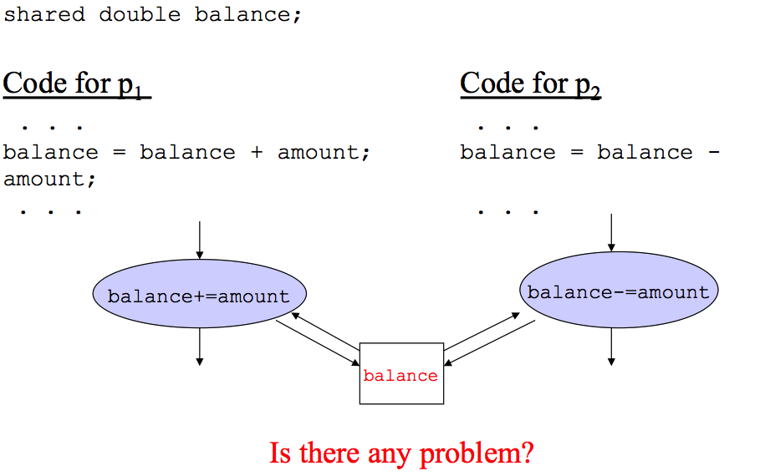
Example: Critical Sections
Q1:
Notes:
At first glance, it may seem that interleaving and overlapping represent fundamentally different modes of execution and present different problems. In fact, both techniques can be viewed as examples of concurrent processing, and both present the same problems. In the case of a uniprocessor, the problems stem from a basic characteristic of multiprogramming systems: The relative speed of execution of processes cannot be predicted. It depends on the activities of other processes, the way in which the OS handles interrupts, and the scheduling policies of the OS.

Slide 6
Race Condition
Occurs when multiple processes or threads read and write data items
The final result depends on the order of execution
the “loser” of the race is the process that updates last and will determine the final value of the variable
Notes:
A race condition occurs when multiple processes or threads read and write data items so that the final result depends on the order of execution of instructions in the multiple processes. Let us consider two simple examples.
As a first example, suppose that two processes, P1 and P2, share the global variable a . At some point in its execution, P1 updates a to the value 1, and at some point in its execution, P2 updates a to the value 2. Thus, the two tasks are in a race to write variable a . In this example, the “loser” of the race (the process that updates last) determines the final value of a .
For our second example, consider two process, P3 and P4, that share global variables b and c , with initial values b = 1 and c = 2 . At some point in its execution, P3 executes the assignment b = b + c , and at some point in its execution, P4 executes the assignment c = b + c . Note that the two processes update different variables. However, the final values of the two variables depend on the order in which the two processes execute these two assignments. If P3 executes its assignment statement first, then the final values are b = 3 and c = 5 . If P4 executes its assignment statement first, then the final values are b = 4 and c = 3 .
Appendix A includes a discussion of race conditions using semaphores as an example.

Slide 7
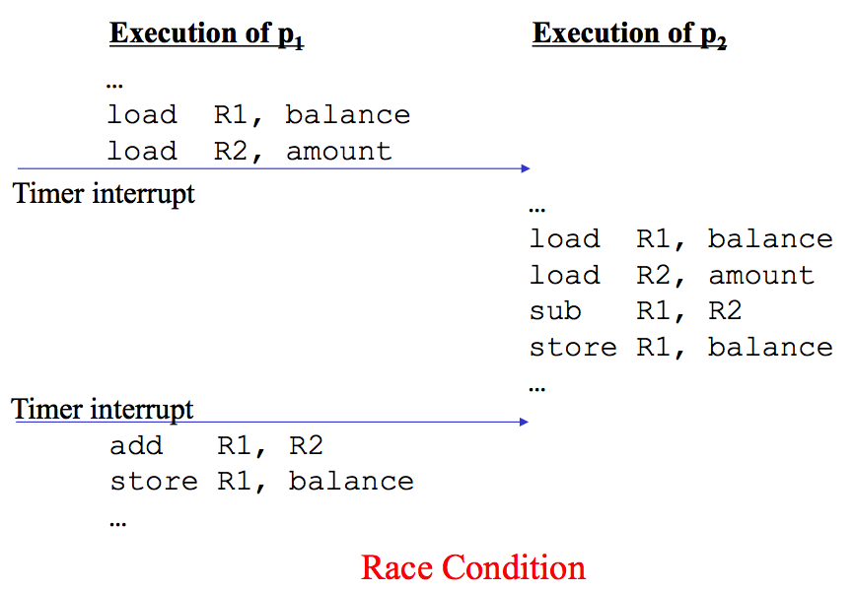
Example: Race Condition
Notes:
The central themes of operating system design are all concerned with the management of processes and threads:
• Multiprogramming: The management of multiple processes within a uniprocessor system
• Multiprocessing : The management of multiple processes within a multiprocessor
• Distributed processing: The management of multiple processes executing on multiple, distributed computer systems. The recent proliferation of clusters is a prime example of this type of system.

Slide 8
Resource Competition
Concurrent processes come into conflict when they are competing for use of the same resource
For example: I/O devices, memory, processor time, clock
In the case of competing processes, there are three control problems:
the need for mutual exclusion
deadlock
starvation
Notes:
Concurrent processes come into conflict with each other when they are competing for the use of the same resource. In its pure form, we can describe the situation as follows. Two or more processes need to access a resource during the course of their execution. Each process is unaware of the existence of other processes, and each is to be unaffected by the execution of the other processes. It follows from this that each process should leave the state of any resource that it uses unaffected. Examples of resources include I/O devices, memory, processor time, and the clock.
There is no exchange of information between the competing processes. However, the execution of one process may affect the behavior of competing processes. In particular, if two processes both wish access to a single resource, then one process will be allocated that resource by the OS, and the other will have to wait. Therefore, the process that is denied access will be slowed down. In an extreme case, the blocked process may never get access to the resource and hence will never terminate successfully.
In the case of competing processes three control problems must be faced. First is the need for mutual exclusion . Suppose two or more processes require access to a single non-sharable resource, such as a printer. During the course of execution, each process will be sending commands to the I/O device, receiving status information, sending data, and/or receiving data. We will refer to such a resource as a critical resource , and the portion of the program that uses it as a critical section of the program. It is important that only one program at a time be allowed in its critical section. We cannot simply rely on the OS to understand and enforce this restriction because the detailed requirements may not be obvious. In the case of the printer, for example, we want any individual process to have control of the printer while it prints an entire file. Otherwise, lines from competing processes will be interleaved.
The enforcement of mutual exclusion creates two additional control problems. One is that of deadlock . For example, consider two processes, P1 and P2, and two resources, R1 and R2. Suppose that each process needs access to both resources to perform part of its function. Then it is possible to have the following situation: the OS assigns R1 to P2, and R2 to P1. Each process is waiting for one of the two resources. Neither will release the resource that it already owns until it has acquired the other resource and performed the function requiring both resources. The two processes are deadlocked.
A final control problem is starvation . Suppose that three processes (P1, P2, P3) each require periodic access to resource R. Consider the situation in which P1 is in possession of the resource, and both P2 and P3 are delayed, waiting for that resource. When P1 exits its critical section, either P2 or P3 should be allowed access to R. Assume that the OS grants access to P3 and that P1 again requires access before P3 completes its critical section. If the OS grants access to P1 after P3 has finished, and subsequently alternately grants access to P1 and P3, then P2 may indefinitely be denied access to the resource, even though there is no deadlock situation.

Slide 9
An Example of Mutual Exclusion
Notes:
Control of competition inevitably involves the OS because it is the OS that allocates resources. In addition, the processes themselves will need to be able to express the requirement for mutual exclusion in some fashion, such as locking a resource prior to its use. Any solution will involve some support from the OS, such as the provision of the locking facility.
Figure 5.1 illustrates the mutual exclusion mechanism in abstract terms. There are n processes to be executed concurrently. Each process includes (1) a critical section that operates on some resource Ra, and (2) additional code preceding and following the critical section that does not involve access to Ra. Because all processes access the same resource Ra, it is desired that only one process at a time be in its critical section. To enforce mutual exclusion, two functions are provided: entercritical and exitcritical . Each function takes as an argument the name of the resource that is the subject of competition. Any process that attempts to enter its critical section while another process is in its critical section, for the same resource, is made to wait.
It remains to examine specific mechanisms for providing the functions entercritical and exitcritical . For the moment, we defer this issue while we consider the other cases of process interaction.

Slide 10
Requirements for Mutual Exclusion
Must be enforced
A process that halts must do so without interfering with other processes
No deadlock or starvation
A process must not be denied access to a critical section when there is no other process using it
No assumptions are made about relative process speeds or number of processes
A process remains inside its critical section for a finite time only
Notes:
Any facility or capability that is to provide support for mutual exclusion should
meet the following requirements:
1. Mutual exclusion must be enforced: Only one process at a time is allowed into
its critical section, among all processes that have critical sections for the same resource or shared object.
2. A process that halts in its noncritical section must do so without interfering
with other processes.
3. It must not be possible for a process requiring access to a critical section to be
delayed indefinitely: no deadlock or starvation.
4. When no process is in a critical section, any process that requests entry to its
critical section must be permitted to enter without delay.
5. No assumptions are made about relative process speeds or number of processors.
6. A process remains inside its critical section for a finite time only.
There are a number of ways in which the requirements for mutual exclusion can be satisfied. One approach is to leave the responsibility with the processes that wish to execute concurrently. Processes, whether they are system programs or application programs, would be required to coordinate with one another to enforce mutual exclusion, with no support from the programming language or the OS. We can refer to these as software approaches. Although this approach is prone to high processing overhead and bugs, it is nevertheless useful to examine such approaches to gain a better understanding of the complexity of concurrent processing. This topic is covered in Appendix A . A second approach involves the use of special purpose machine instructions. These have the advantage of reducing overhead but nevertheless will be shown to be unattractive as a general-purpose solution; they are covered in Section 5.2 . A third approach is to provide some level of support within the OS or a programming language. Three of the most important such approaches are examined in Sections 5.3 through 5.5 .

Slide 11
Mutual Exclusion: Hardware Support
Interrupt Disabling
uniprocessor system
disabling interrupts
guarantees mutual
exclusion
Disadvantages:
the efficiency of
execution could be
noticeably degraded
this approach will not
work in a
multiprocessor
architecture
Notes:
In a uniprocessor system, concurrent processes cannot have overlapped execution;
they can only be interleaved. Furthermore, a process will continue to run until it
invokes an OS service or until it is interrupted. Therefore, to guarantee mutual exclusion,
it is sufficient to prevent a process from being interrupted. This capability
can be provided in the form of primitives defined by the OS kernel for disabling and
enabling interrupts.
Because the critical section cannot be interrupted, mutual exclusion is guaranteed.
The price of this approach, however, is high. The efficiency of execution could
be noticeably degraded because the processor is limited in its ability to interleave
processes. Another problem is that this approach will not work in a multiprocessor
architecture. When the computer includes more than one processor, it is possible (and
typical) for more than one process to be executing at a time. In this case, disabled
interrupts do not guarantee mutual exclusion.

Slide 12
Critical Section Problem
Consider system of n processes {p₀, p₁, … p_{n-1}}
Each process has critical section segment of code
Process may be changing common variables, updating table, writing file, etc
When one process in critical section, no other may be in its critical section
Each process must ask permission to enter critical section in entry section, may follow critical section with exit section, then remainder section
Notes:
Consider system of n processes {p₀, p₁, … p_{n-1}}
Each process has critical section segment of code
Process may be changing common variables, updating table, writing file, etc
When one process in critical section, no other may be in its critical section
Critical section problem is to design protocol to solve this
Each process must ask permission to enter critical section in entry section, may follow critical section with exit section, then remainder section

Slide 13
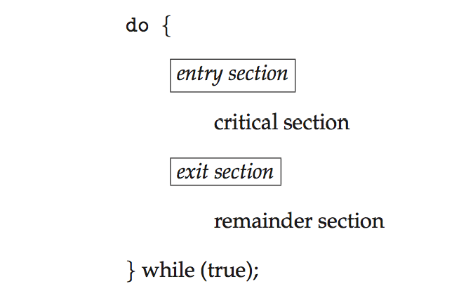
General structure of process P_{i}

Slide 14
Algorithm for Process P_{i}
do {
while (turn == j);
critical section
turn = j;
remainder section
} while (true);

Slide 15
Solution to Critical-Section Problem
1. Mutual Exclusion If process P_{i} is executing in its critical section, then
2. Progress If no process is executing in its critical section and there exist some processes that wish to enter their critical section, then
3. Bounded Waiting A bound must exist on the number of times that other processes are allowed to enter their critical sections after a process has made a request to enter its critical section and before that request is grant
Notes:
Mutual Exclusion - If process P_{i} is executing in its critical section, then no other processes can be executing in their critical sections
2. Progress - If no process is executing in its critical section and there exist some processes that wish to enter their critical section, then the selection of the processes that will enter the critical section next cannot be postponed indefinitely
3. Bounded Waiting - A bound must exist on the number of times that other processes are allowed to enter their critical sections after a process has made a request to enter its critical section and before that request is granted
Assume that each process executes at a nonzero speed
No assumption concerning relative speed of the n processes

Slide 16
Peterson’s Solution
Assumption: the load and store instructions are atomic
The two processes share two variables:
int turn;
Boolean flag[2]
turn: whose turn it is to enter the critical section
flag: to indicate if a process is ready to enter the critical section. flag[i] = true implies that process P_{i} is ready!
Notes:
It was formulated by Gary L. Peterson in 1981.
Reference: https://en.wikipedia.org/wiki/Peterson%27s_algorithm
Good algorithmic description of solving the problem
Two process solution
Assume that the load and store machine-language instructions are atomic; that is, cannot be interrupted
The two processes share two variables:
int turn;
Boolean flag[2]
The variable turn indicates whose turn it is to enter the critical section
The flag array is used to indicate if a process is ready to enter the critical section. flag[i] = true implies that process P_{i} is ready!

Slide 17
Q3: Can you explain the Peterson’s algorithm?
do {
flag[i] = true;
turn = j;
while (flag[j] && turn = = j);
critical section
flag[i] = false;
remainder section
} while (true);
Notes:
Question: How to control turns?

Slide 18
Peterson’s Solution (Cont.)
Provable that the three CS requirement are met:
1. Mutual exclusion is preserved
P_{i} enters CS only if:
either flag[j] = false
or turn = i
2. Progress requirement is satisfied
3. Bounded-waiting requirement is met

Slide 19
Synchronization Hardware
All solutions below based on idea of locking
Protecting critical regions via locks
Uniprocessors – Disable interrupts
Running code cannot be preempted
Generally too inefficient on multiprocessor systems
Special atomic hardware instructions
Atomic = non-interruptible
Either test memory word and set value
Or swap contents of two memory words
Q4: Any Problem?
Notes:
Many systems provide hardware support for implementing the critical section code.
All solutions below based on idea of locking
Protecting critical regions via locks
Uniprocessors – could disable interrupts
Currently running code would execute without preemption
Generally too inefficient on multiprocessor systems
Operating systems using this not broadly scalable
Modern machines provide special atomic hardware instructions
Atomic = non-interruptible
Either test memory word and set value
Or swap contents of two memory words

Slide 20
Solution to Critical-section Problem Using Locks
do {
acquire lock
critical section
release lock
remainder section
} while (TRUE);

Slide 21
test_and_set Instruction
boolean test_and_set (boolean *target)
{
boolean rv = *target;
*target = TRUE;
return rv;
}
Executed atomically
Returns the original value of passed parameter
Set the new value of passed parameter to “TRUE”.

Slide 22
Solution using test_and_set()
Shared Boolean variable lock, initialized to FALSE
Solution:
do { /* do nothing */
while (test_and_set(&lock));
/* critical section */
lock = false;
/* remainder section */
} while (true);

Slide 23
Summary
Critical Sections
Peterson’s Solution
Mutual exclusion: hardware support
Interrupt disabling
Special machine instructions
Notes:
Summary of Chapter 5.

